Slide 1
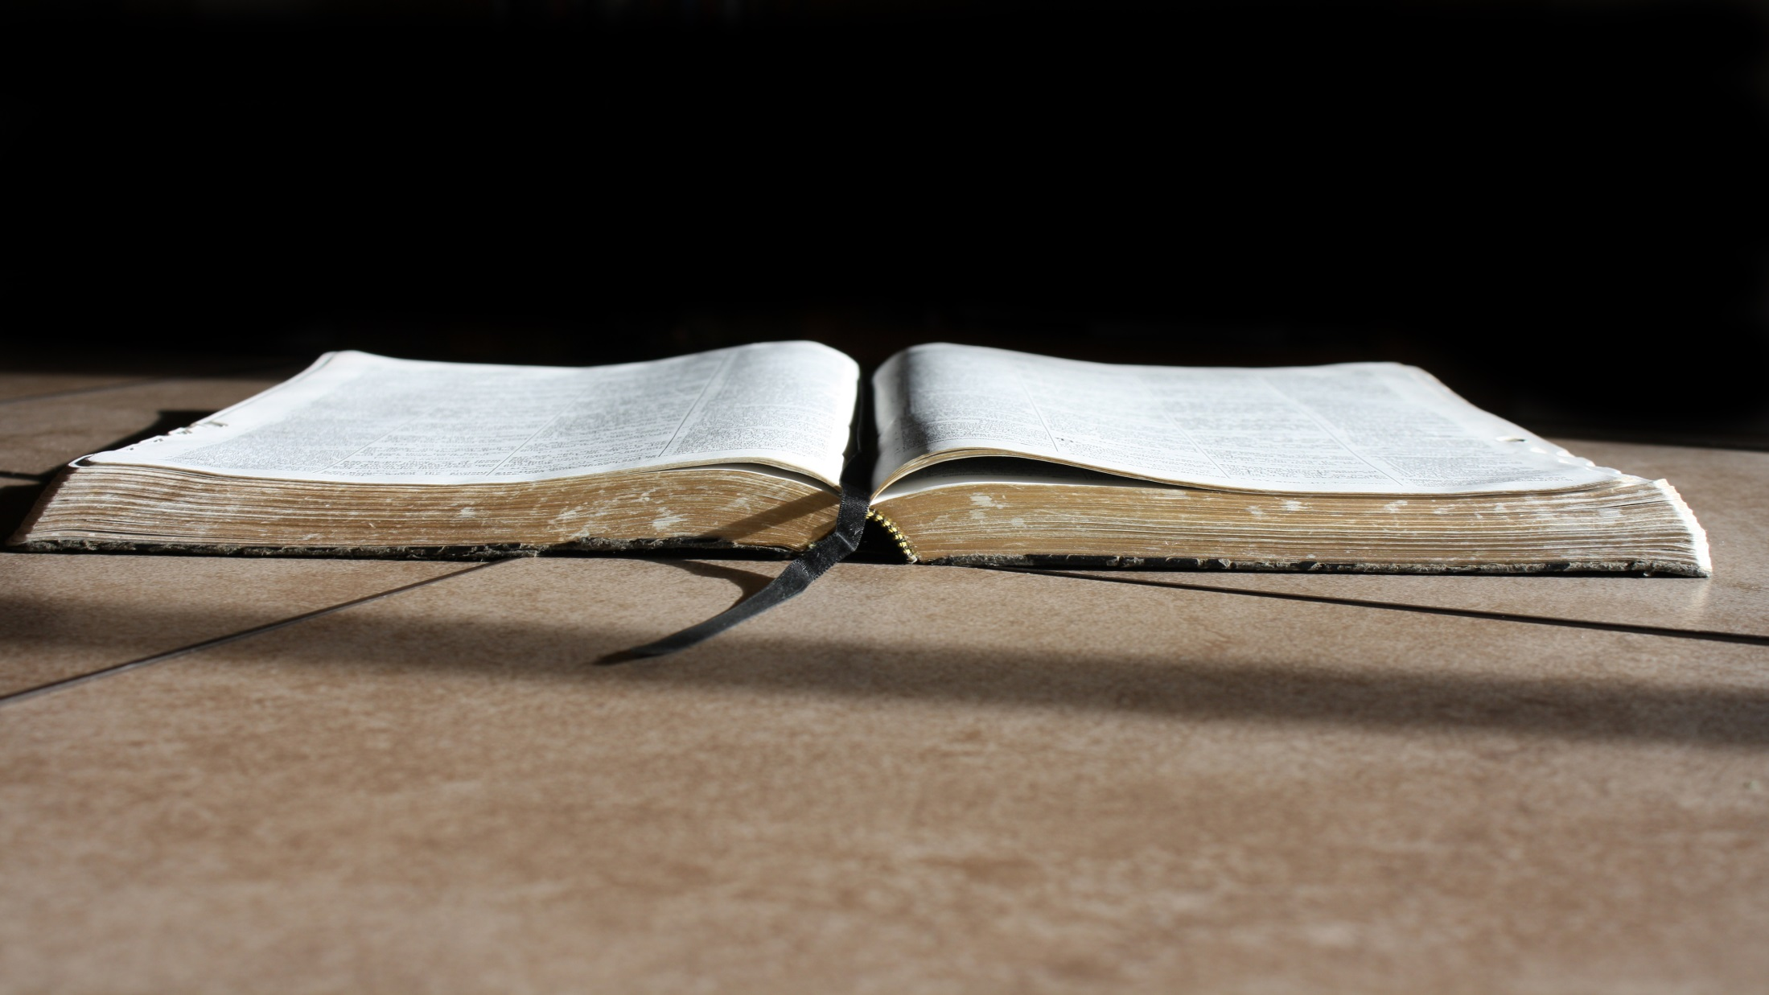
What should I do with the Word?
Psalm 119:41-48

Slide 2
We should be saved by it.
41 Let Your mercies come also to me, O Lord —Your salvation according to Your word
Psalm 119:41
Therefore lay aside all filthiness and overflow of wickedness, and receive with meekness the implanted word, which is able to save your souls.
James 1:21

Slide 3
We should be saved by it.
10 and with all unrighteous deception among those who perish, because they did not receive the love of the truth, that they might be saved.
2 Thessalonians 2:10

Slide 4
We should trust it.
So shall I have an answer for him who reproaches me, For I trust in Your word.
Psalm 119:42

Slide 5
We should trust it.
So shall I have an answer for him who reproaches me, For I trust in Your word.
Psalm 119:42
5 Thus says the Lord:" Cursed is the man who trusts in man And makes flesh his strength, Whose heart departs from the Lord. Jeremiah 17:5

Slide 6
We should trust it.
26 He who trusts in his own heart is a fool, But whoever walks wisely will be delivered.
Proverbs 28:26
5 Trust in the Lord with all your heart,And lean not on your own understanding;
Proverbs 3:5

Slide 7
We should hope in it.
43 And take not the word of truth utterly out of my mouth, For I have hoped in Your ordinances.
Psalm 119:43

Slide 8
We should hope in it.
3 Blessed be the God and Father of our Lord Jesus Christ, who according to His abundant mercy has begotten us again to a living hope through the resurrection of Jesus Christ from the dead,
1 Peter 1:3

Slide 9
We should hope in it.
22 Since you have purified your souls in obeying the truth through the Spirit in sincere love of the brethren, love one another fervently with a pure heart,
1 Peter 1:22

Slide 10
We should hope in it.
15 But sanctify the Lord God in your hearts, and always be ready to give a defense to everyone who asks you a reason for the hope that is in you, with meekness and fear;
1 Peter 3:15

Slide 11
We should keep it.
44 So shall I keep Your law continually, Forever and ever.
Psalm 119:44

Slide 12
We should keep it.
17 Her ways are ways of pleasantness, And all her paths are peace.
Proverbs 3:17

Slide 13
We should seek it.
45 And I will walk at liberty, For I seek Your precepts.
Psalm 119:45

Slide 14
We should seek it.
6 For in Christ Jesus neither circumcision nor uncircumcision avails anything, but faith working through love.
Galatians 5:6

Slide 15
We should seek it.
32 And you shall know the truth, and the truth shall make you free.“ John 8:32
36 Therefore if the Son makes you free, you shall be free indeed. John 8:36

Slide 16
We should speak it, even in high places
46 I will speak of Your testimonies also before kings, And will not be ashamed.
Psalm 119:46

Slide 17
We should speak it, even in high places
18 You will be brought before governors and kings for My sake, as a testimony to them and to the Gentiles.
Matthew 10:18

Slide 18
We should delight in it.
47 And I will delight myself in Your commandments, Which I love.
Psalm 119:47

Slide 19
We should delight in it.
4 Delight yourself also in the Lord, And He shall give you the desires of your heart.
Psalm 37:4

Slide 20
We should delight in it.
32 But He said to them, " I have food to eat of which you do not know."33 Therefore the disciples said to one another, "Has anyone brought Him anything to eat?"34 Jesus said to them, " My food is to do the will of Him who sent Me, and to finish His work.
John 4:32-34

Slide 21
We should delight in it.
7 and the peace of God, which surpasses all understanding, will guard your hearts and minds through Christ Jesus.
Philippians 4:7

Slide 22
We should respect it and meditate upon it.
48 My hands also I will lift up to Your commandments, Which I love, And I will meditate on Your statutes.
Psalm 119:48

Slide 23
We should respect it and meditate upon it.
22 But Abram said to the king of Sodom, "I have raised my hand to the Lord, God Most High, the Possessor of heaven and earth,
Genesis 14:22

Slide 24
Conclusion

