Slide 1
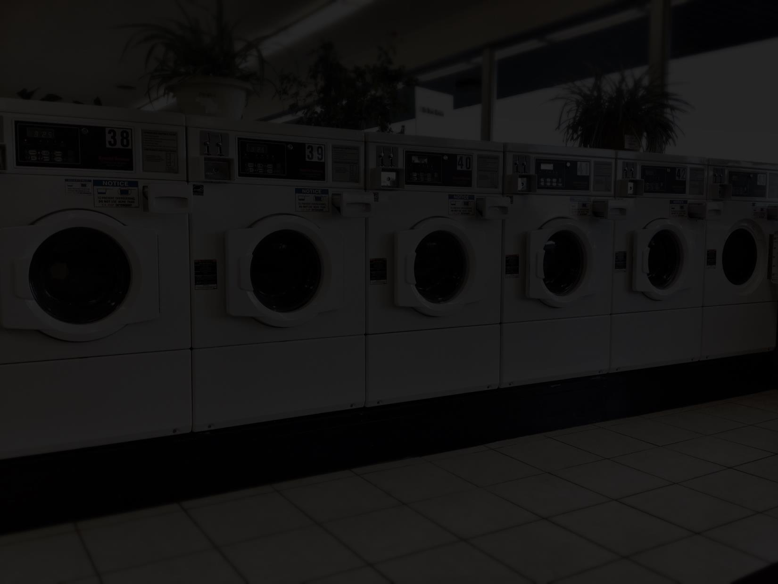
Romans 6:12-13
Therefore do not let sin reign in your mortal body, that you should obey it in its lusts. 13 And do not present your members as instruments of unrighteousness to sin, but present yourselves to God as being alive from the dead, and your members as instruments of righteousness to God.

Slide 2
What does the Bible say about Repentance

Slide 3
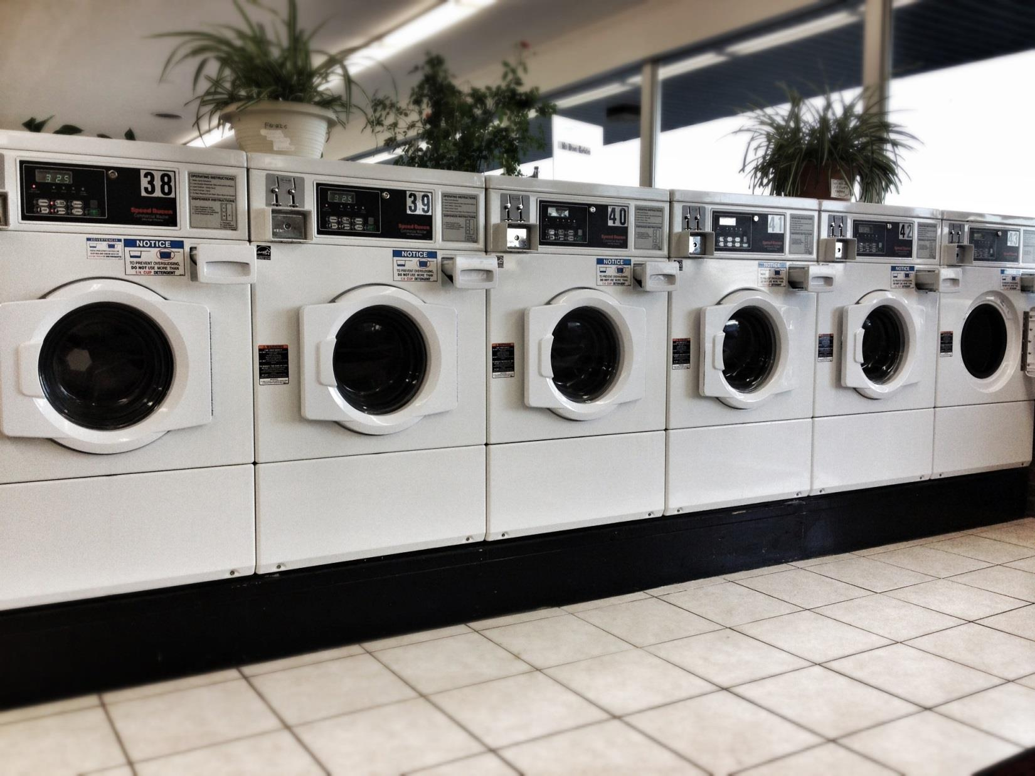

Slide 4
Romans 6:12-13
Therefore do not let sin reign in your mortal body, that you should obey it in its lusts. 13 And do not present your members as instruments of unrighteousness to sin, but present yourselves to God as being alive from the dead, and your members as instruments of righteousness to God.

Slide 5
Psalm 51:7
Purge me with hyssop, and I shall be clean; Wash me, and I shall be whiter than snow.

Slide 6
What does the world say is Repentance?
"A son honors his father, And a servant his master. If then I am the Father, Where is My honor? And if I am a Master, Where is My reverence? Says the Lord of hosts To you priests who despise My name. Yet you say, 'In what way have we despised Your name? ‘
Malachi 1:6

Slide 7
What does the world say is Repentance?
Therefore do not let sin reign in your mortal body, that you should obey it in its lusts. 13 And do not present your members as instruments of unrighteousness to sin, but present yourselves to God as being alive from the dead, and your members as instruments of righteousness to God.
Romans 6:12-13

Slide 8
What does the world say is Repentance?
So the people of Nineveh believed God, proclaimed a fast, and put on sackcloth, from the greatest to the least of them. 6 Then word came to the king of Nineveh; and he arose from his throne and laid aside his robe, covered himself with sackcloth and sat in ashes.

Slide 9
What does the world say is Repentance?
7 And he caused it to be proclaimed and published throughout Nineveh by the decree of the king and his nobles, saying, Let neither man nor beast, herd nor flock, taste anything; do not let them eat, or drink water. 8 But let man and beast be covered with sackcloth, and cry mightily to God; yes, let every one turn from his evil way and from the violence that is in his hands. Jonah 3:5-8

Slide 10
What does the Bible say is Repentance?
O Jerusalem, wash your heart from wickedness, That you may be saved. How long shall your evil thoughts lodge within you?
Jeremiah 4:14

Slide 11
What does the Bible say is Repentance?
What shall we say then? Shall we continue in sin that grace may abound?
Romans 6:1

Slide 12
What does the Bible say is Repentance?
But in accordance with your hardness and your impenitent heart you are treasuring up for yourself wrath in the day of wrath and revelation of the righteous judgment of God,
Romans 2:5

Slide 13
Are you willing to repent in every situation?
But now you boast in your arrogance. All such boasting is evil.
James 4:16

Slide 14
Are you willing to repent in every situation?
I acknowledged my sin to You, And my iniquity I have not hidden. I said, "I will confess my transgressions to the Lord,“ And You forgave the iniquity of my sin. Selah
Psalm 32:5

Slide 15
Are you willing to repent in every situation?
Beware lest anyone cheat you through philosophy and empty deceit, according to the tradition of men, according to the basic principles of the world, and not according to Christ.
Colossians 2:8

Slide 16
Are you willing to repent in every situation?
And if it seems evil to you to serve the Lord, choose for yourselves this day whom you will serve, whether the gods which your fathers served that were on the other side of the River, or the gods of the Amorites, in whose land you dwell. But as for me and my house, we will serve the Lord.“
Joshua 24:15

Slide 17
Are you willing to repent in every situation?
3 The Pharisees also came to Him, testing Him, and saying to Him, "Is it lawful for a man to divorce his wife for just any reason?"4 And He answered and said to them, " Have you not read that He who made them at the beginning ' made them male and female, ' 5 and said, "For this reason a man shall leave his father and mother and be joined to his wife, and the two shall become one flesh '?

Slide 18
Are you willing to repent in every situation?
7 They said to Him, " Why then did Moses command to give a certificate of divorce, and to put her away?"8 He said to them, " Moses, because of the hardness of your hearts, permitted you to divorce your wives, but from the beginning it was not so.

Slide 19
Are you willing to repent in every situation?
9 And I say to you, whoever divorces his wife, except for sexual immorality, and marries another, commits adultery; and whoever marries her who is divorced commits adultery.“
Matthew 19:3-9

Slide 20
Are you willing to repent in every situation?
And they gave their promise that they would put away their wives; and being guilty, they presented a ram of the flock as their trespass offering.
Ezra 10:19

Slide 21
Are you willing to repent in every situation?
lest, when I come again, my God will humble me among you, and I shall mourn for many who have sinned before and have not repented of the uncleanness, fornication, and lewdness which they have practiced.
2 Corinthians 12:21

Slide 22
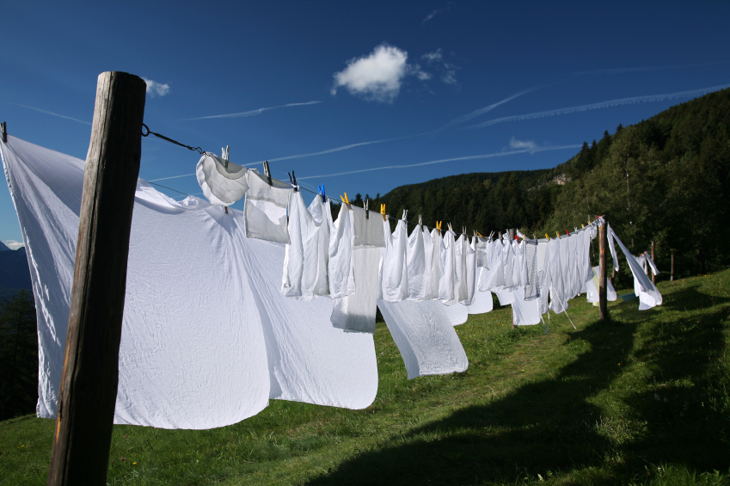

Slide 23
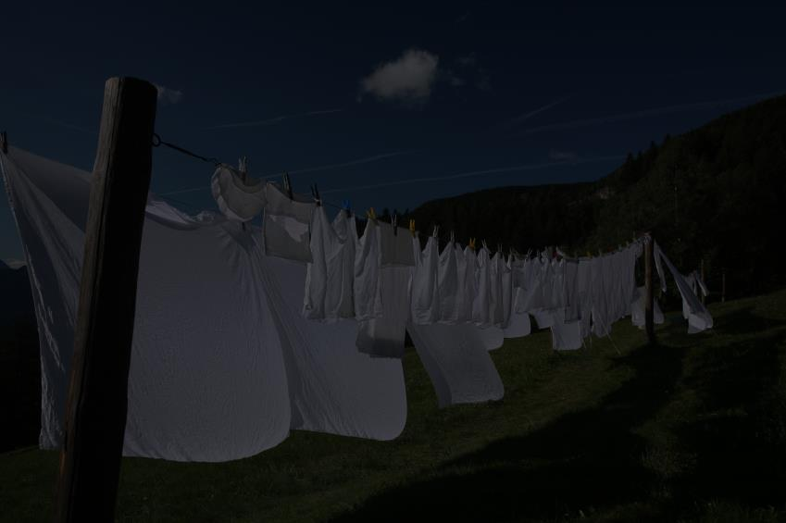
Conclusion
What about your soul?
Are you willing to do what is necessary to be right with God?

Slide 24
Conclusion
Now therefore, please pardon my sin, and return with me, that I may worship the Lord.“
1 Samuel 15:25
It may be that the house of Judah will hear all the adversities which I purpose to bring upon them, that everyone may turn from his evil way, that I may forgive their iniquity and their sin.“ Jeremiah 36:3

Slide 25
Conclusion
3. Are you ready to have your sins washed away?
and from Jesus Christ, the faithful witness, the firstborn from the dead, and the ruler over the kings of the earth. To Him who loved us and washed us from our sins in His own blood,
Revelation 1:5

