Slide 1
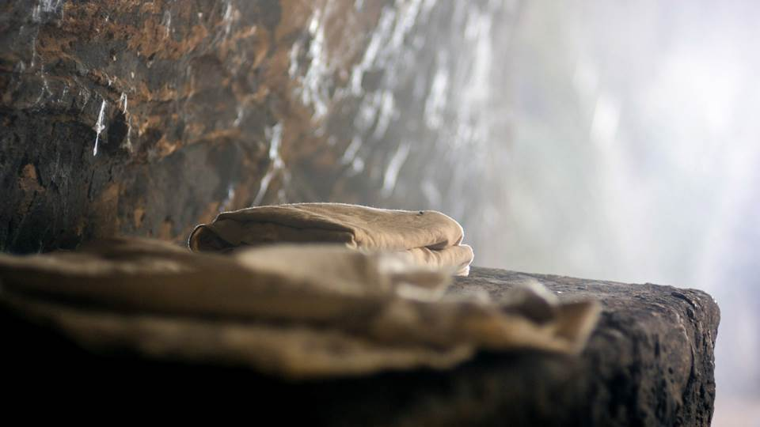
He is not here…
Matthew 28:1-8

Slide 2
Matthew 28:1-8
Now after the Sabbath, as the first day of the week began to dawn, Mary Magdalene and the other Mary came to see the tomb. 2 And behold, there was a great earthquake; for an angel of the Lord descended from heaven, and came and rolled back the stone from the door, and sat on it. 3 His countenance was like lightning, and his clothing as white as snow. 4 And the guards shook for fear of him, and became like dead men.

Slide 3
Matthew 28:1-8
But the angel answered and said to the women, "Do not be afraid, for I know that you seek Jesus who was crucified. 6 He is not here; for He is risen, as He said. Come, see the place where the Lord lay. 7 And go quickly and tell His disciples that He is risen from the dead, and indeed He is going before you into Galilee; there you will see Him. Behold, I have told you."8 So they went out quickly from the tomb with fear and great joy, and ran to bring His disciples word.

Slide 4
Mary at the Tomb
Now after the Sabbath, as the first day of the week began to dawn, Mary Magdalene and the other Mary came to see the tomb. 2 And behold, there was a great earthquake; for an angel of the Lord descended from heaven, and came and rolled back the stone from the door, and sat on it. 3 His countenance was like lightning, and his clothing as white as snow. 4 And the guards shook for fear of him, and became like dead men.

Slide 5
Mary at the Tomb
But the angel answered and said to the women, "Do not be afraid, for I know that you seek Jesus who was crucified. 6 He is not here; for He is risen, as He said. Come, see the place where the Lord lay. 7 And go quickly and tell His disciples that He is risen from the dead, and indeed He is going before you into Galilee; there you will see Him. Behold, I have told you."

Slide 6
Mary at the Tomb
So they went out quickly from the tomb with fear and great joy, and ran to bring His disciples word. And as they went to tell His disciples, behold, Jesus met them, saying, " Rejoice!" So they came and held Him by the feet and worshiped Him. 10 Then Jesus said to them, " Do not be afraid. Go and tell My brethren to go to Galilee, and there they will see Me.“
Matthew 28:1-10

Slide 7
The Soldiers are bribed
Now while they were going, behold, some of the guard came into the city and reported to the chief priests all the things that had happened. 12 When they had assembled with the elders and consulted together, they gave a large sum of money to the soldiers, 13 saying, " Tell them, ' His disciples came at night and stole Him away while we slept. ' 14 And if this comes to the governor's ears, we will appease him and make you secure."

Slide 8
The Soldiers are bribed
15 So they took the money and did as they were instructed; and this saying is commonly reported among the Jews until this day.
Matthew 28:11-15

Slide 9
Peter & the other disciple
Now the first day of the week Mary Magdalene went to the tomb early, while it was still dark, and saw that the stone had been taken away from the tomb. 2 Then she ran and came to Simon Peter, and to the other disciple, whom Jesus loved, and said to them, "They have taken away the Lord out of the tomb, and we do not know where they have laid Him."3 Peter therefore went out, and the other disciple, and were going to the tomb. 4 So they both ran together, and the other disciple outran Peter and came to the tomb first.

Slide 10
Peter & the other disciple
And he, stooping down and looking in, saw the linen cloths lying there; yet he did not go in. 6 Then Simon Peter came, following him, and went into the tomb; and he saw the linen cloths lying there, 7 and the handkerchief that had been around His head, not lying with the linen cloths, but folded together in a place by itself. 8 Then the other disciple, who came to the tomb first, went in also; and he saw and believed.

Slide 11
Peter & the other disciple
9 For as yet they did not know the Scripture, that He must rise again from the dead. 10 Then the disciples went away again to their own homes.
John 20:1-10

Slide 12
Mary unknowingly sees Jesus
But Mary stood outside by the tomb weeping, and as she wept she stooped down and looked into the tomb. 12 And she saw two angels in white sitting, one at the head and the other at the feet, where the body of Jesus had lain. 13 Then they said to her, " Woman, why are you weeping?“ She said to them, " Because they have taken away my Lord, and I do not know where they have laid Him."14 Now when she had said this, she turned around and saw Jesus standing there, and did not know that it was Jesus.

Slide 13
Mary unknowingly sees Jesus
Jesus said to her, " Woman, why are you weeping? Whom are you seeking?"She, supposing Him to be the gardener, said to Him, " Sir, if You have carried Him away, tell me where You have laid Him, and I will take Him away."16 Jesus said to her, " Mary!"She turned and said to Him, " Rabboni!" (w hich is to say, Teacher).17 Jesus said to her, " Do not cling to Me, for I have not yet ascended to My Father; but go to My brethren and say to them, 'I am ascending to My Father and your Father, and to My God and your God. '

Slide 14
Mary unknowingly sees Jesus
18 Mary Magdalene came and told the disciples that she had seen the Lord, and that He had spoken these things to her.
John 20:11-18

Slide 15
Walking & Talking with Jesus
Luke 24:13-35

Slide 16
Jesus’ sudden appearance to His disciples
36 Now as they said these things, Jesus Himself stood in the midst of them, and said to them, " Peace to you." 37 But they were terrified and frightened, and supposed they had seen a spirit. 38 And He said to them, " Why are you troubled? And why do doubts arise in your hearts? 39 Behold My hands and My feet, that it is I Myself. Handle Me and see, for a spirit does not have flesh and bones as you see I have."40 When He had said this, He showed them His hands and His feet.

Slide 17
Jesus’ sudden appearance to His disciples
But while they still did not believe for joy, and marveled, He said to them, " Have you any food here?" 42 So they gave Him a piece of a broiled fish and some honeycomb. 43 And He took it and ate in their presence.44 Then He said to them, " These are the words which I spoke to you while I was still with you, that all things must be fulfilled which were written in the Law of Moses and the Prophets and the Psalms concerning Me." 45 And He opened their understanding, that they might comprehend the Scriptures.

Slide 18
Jesus’ sudden appearance to His disciples
46 Then He said to them, " Thus it is written, and thus it was necessary for the Christ to suffer and to rise from the dead the third day, 47 and that repentance and remission of sins should be preached in His name to all nations, beginning at Jerusalem. 48 And you are witnesses of these things.
Luke 24:36-48

Slide 19
What Christ’s resurrection means to you
If Christ is not risen - 1 Corinthians 15:1-18
Christ has risen – 1 Corinthians 15:20-22
20 But now Christ is risen from the dead, and has become the firstfruits of those who have fallen asleep. 21 For since by man came death, by Man also came the resurrection of the dead. 22 For as in Adam all die, even so in Christ all shall be made alive.

Slide 20
Conclusion
1. Christ indeed rose from the grave, as it could not hold him.
2. Today, if we are followers of Christ, when this life is over we too will be raised and will join Him in the heavenly home.

