Slide 1
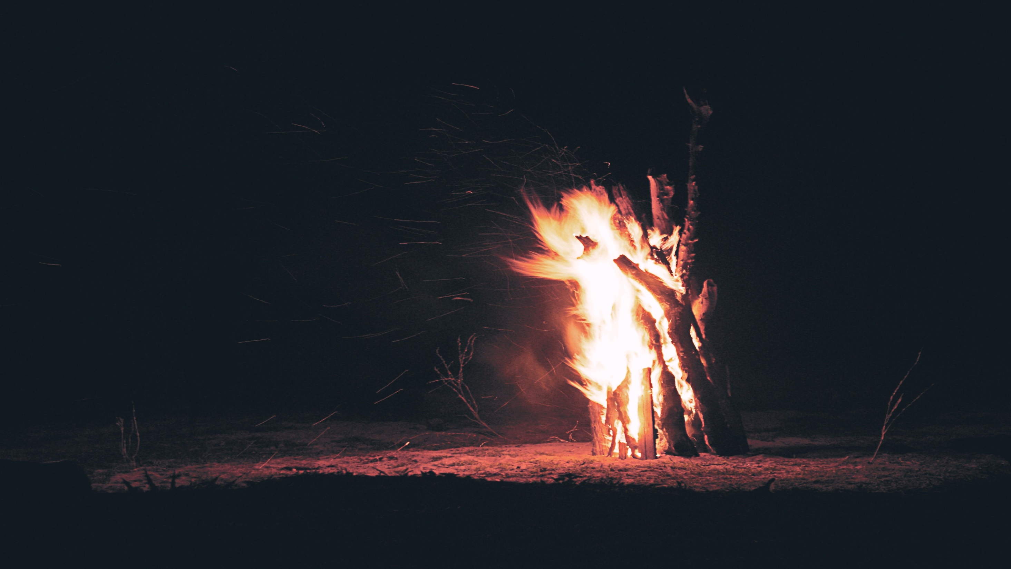
Old Testament Characters: Josiah 2 Kings 23:1-3

Slide 2
Background of Josiah’s Reign

Slide 3
Was the complete opposite of his grandfather Manasseh.
Manasseh even built pagan altars in the temple and sacrificed children to Molech

Slide 4
Was the complete opposite of his grandfather Manasseh.
Amon the son of Manasseh was wicked like his father
Amon was twenty- two years old when he became king, and he reigned two years in Jerusalem. 22 But he did evil in the sight of the Lord, as his father Manasseh had done; for Amon sacrificed to all the carved images which his father Manasseh had made, and served them. 23 And he did not humble himself before the Lord, as his father Manasseh had humbled himself; but Amon trespassed more and more.
2 Chronicles 33:21-23

Slide 5
Was the complete opposite of his grandfather Manasseh.
Then his servants conspired against him, and killed him in his own house.
2 Chronicles 33:24

Slide 6
Josiah accomplished much, but not enough.
"And it shall be, when you show this people all these words, and they say to you, ' Why has the Lord pronounced all this great disaster against us? Or what is our iniquity? Or what is our sin that we have committed against the Lord our God? ' 11 then you shall say to them, 'Because your fathers have forsaken Me,' says the Lord; 'they have walked after other gods and have served them and worshiped them, and have forsaken Me and not kept My law. 12 And you have done worse than your fathers, for behold, each one follows the dictates of his own evil heart, so that no one listens to Me.

Slide 7
Josiah accomplished much, but not enough.
13 Therefore I will cast you out of this land into a land that you do not know, neither you nor your fathers; and there you shall serve other gods day and night, where I will not show you favor. Jeremiah 16:10-13

Slide 8
Josiah accomplished much, but not enough.
"The sin of Judah is written with a pen of iron; With the point of a diamond it is engraved On the tablet of their heart, And on the horns of your altars,2 While their children remember Their altars and their wooden images By the green trees on the high hills.3 O My mountain in the field, I will give as plunder your wealth, all your treasures, And your high places of sin within all your borders.4 And you, even yourself, Shall let go of your heritage which I gave you; And I will cause you to serve your enemies In the land which you do not know; For you have kindled a fire in My anger which shall burn forever."
Jeremiah 17:1-4

Slide 9
The Reign of Josiah

Slide 10
The Early Years
Josiah was eight years old when he became king, and he reigned thirty- one years in Jerusalem. 2 And he did what was right in the sight of the Lord, and walked in the ways of his father David; he did not turn aside to the right hand or to the left.3 For in the eighth year of his reign, while he was still young, he began to seek the God of his father David; and in the twelfth year he began to purge Judah and Jerusalem of the high places, the wooden images, the carved images, and the molded images. 2 Chronicles 34:1-3

Slide 11
The Early Years
They broke down the altars of the Baals in his presence, and the incense altars which were above them he cut down; and the wooden images, the carved images, and the molded images he broke in pieces, and made dust of them and scattered it on the graves of those who had sacrificed to them.
2 Chronicles 34:4

Slide 12
The Temple Repaired & the Law Discovered
Now it happened, when the king heard the words of the Book of the Law, that he tore his clothes. 12 Then the king commanded Hilkiah the priest, Ahikam the son of Shaphan, Achbor the son of Michaiah, Shaphan the scribe, and Asaiah a servant of the king, saying, 13 " Go, inquire of the Lord for me, for the people and for all Judah, concerning the words of this book that has been found; for great is the wrath of the Lord that is aroused against us, because our fathers have not obeyed the words of this book, to do according to all that is written concerning us."
2 Kings 22:11-13

Slide 13
The Great Restoration
Then the king sent and gathered all the elders of Judah and Jerusalem. 30 The king went up to the house of the Lord, with all the men of Judah and the inhabitants of Jerusalem —the priests and the Levites, and all the people, great and small. And he read in their hearing all the words of the Book of the Covenant which had been found in the house of the Lord. 31 Then the king stood in his place and made a covenant before the Lord, to follow the Lord, and to keep His commandments and His testimonies and His statutes with all his heart and all his soul, to perform the words of the covenant that were written in this book. 2 Chronicles 34:29-31

Slide 14
The Great Restoration
And he made all who were present in Jerusalem and Benjamin take a stand. So the inhabitants of Jerusalem did according to the covenant of God, the God of their fathers. 33 Thus Josiah removed all the abominations from all the country that belonged to the children of Israel, and made all who were present in Israel diligently serve the Lord their God. All his days they did not depart from following the Lord God of their fathers.
2 Chronicles 34:32-33

Slide 15
The End Of Josiah
22 Nevertheless Josiah would not turn his face from him, but disguised himself so that he might fight with him, and did not heed the words of Necho from the mouth of God. So he came to fight in the Valley of Megiddo.
2 Chronicles 35:22

Slide 16
The End Of Josiah
His servants therefore took him out of that chariot and put him in the second chariot that he had, and they brought him to Jerusalem. So he died, and was buried in one of the tombs of his fathers. And all Judah and Jerusalem mourned for Josiah.25 Jeremiah also lamented for Josiah. And to this day all the singing men and the singing women speak of Josiah in their lamentations. They made it a custom in Israel; and indeed they are written in the Laments.
2 Chronicles 35:24-25

Slide 17
Lessons for Us Today

Slide 18
We do not have to Follow our evil predecessors
And he did what was right in the sight of the Lord, and walked in the ways of his father David; he did not turn aside to the right hand or to the left.
2 Chronicles 34:2

Slide 19
Every Generation has an obligation to maintain that which has been restored.
Jehoiakim was twenty- five years old when he became king, and he reigned eleven years in Jerusalem. His mother's name was Zebudah the daughter of Pedaiah of Rumah. 37 And he did evil in the sight of the Lord, according to all that his fathers had done.
2 Kings 23:36-37

Slide 20
Conclusion
1. It is not enough to stand against evil and stand for God.
2. We must teach others and those of our household to do the same.
3. Until then, evil can return with the next leader or generation.

