Slide 1
Lesson 10 Exodus 14:13-16

Slide 2
Exodus 14:13-16
13 And Moses said to the people, "Do not be afraid. Stand still, and see the salvation of the Lord, which He will accomplish for you today. For the Egyptians whom you see today, you shall see again no more forever. 14 The Lord will fight for you, and you shall hold your peace."15 And the Lord said to Moses, "Why do you cry to Me? Tell the children of Israel to go forward.

Slide 3
Exodus 14:13-16
16 But lift up your rod, and stretch out your hand over the sea and divide it. And the children of Israel shall go on dry ground through the midst of the sea.

Slide 4
Pursued by Pharaoh
Now the Lord spoke to Moses, saying:2 " Speak to the children of Israel, that they turn and camp before Pi Hahiroth, between Migdol and the sea, opposite Baal Zephon; you shall camp before it by the sea. 3 For Pharaoh will say of the children of Israel, 'They are bewildered by the land; the wilderness has closed them in. '

Slide 5
Pursued by Pharaoh
4 Then I will harden Pharaoh 's heart, so that he will pursue them; and I will gain honor over Pharaoh and over all his army, that the Egyptians may know that I am the Lord." And they did so. 5 Now it was told the king of Egypt that the people had fled, and the heart of Pharaoh and his servants was turned against the people; and they said, "Why have we done this, that we have let Israel go from serving us?"

Slide 6
Pursued by Pharaoh
6 So he made ready his chariot and took his people with him. 7 Also, he took six hundred choice chariots, and all the chariots of Egypt with captains over every one of them. 8 And the Lord hardened the heart of Pharaoh king of Egypt, and he pursued the children of Israel; and the children of Israel went out with boldness.

Slide 7
Pursued by Pharaoh
9 So the Egyptians pursued them, all the horses and chariots of Pharaoh, his horsemen and his army, and overtook them camping by the sea beside Pi Hahiroth, before Baal Zephon.10 And when Pharaoh drew near, the children of Israel lifted their eyes, and behold, the Egyptians marched after them. So they were very afraid, and the children of Israel cried out to the Lord.

Slide 8
Pursued by Pharaoh
11 Then they said to Moses, "Because there were no graves in Egypt, have you taken us away to die in the wilderness? Why have you so dealt with us, to bring us up out of Egypt? 12 Is this not the word that we told you in Egypt, saying, "Let us alone that we may serve the Egyptians '? For it would have been better for us to serve the Egyptians than that we should die in the wilderness.“ Exodus 14:1-12

Slide 9
Protection of God
13 And Moses said to the people, "Do not be afraid. Stand still, and see the salvation of the Lord, which He will accomplish for you today. For the Egyptians whom you see today, you shall see again no more forever. 14 The Lord will fight for you, and you shall hold your peace."15 And the Lord said to Moses, "Why do you cry to Me? Tell the children of Israel to go forward.

Slide 10
Protection of God
16 But lift up your rod, and stretch out your hand over the sea and divide it. And the children of Israel shall go on dry ground through the midst of the sea. 17 And I indeed will harden the hearts of the Egyptians, and they shall follow them. So I will gain honor over Pharaoh and over all his army, his chariots, and his horsemen.

Slide 11
Protection of God
18 Then the Egyptians shall know that I am the Lord, when I have gained honor for Myself over Pharaoh, his chariots, and his horsemen."19 And the Angel of God, who went before the camp of Israel, moved and went behind them; and the pillar of cloud went from before them and stood behind them.

Slide 12
Protection of God
20 So it came between the camp of the Egyptians and the camp of Israel. Thus it was a cloud and darkness to the one, and it gave light by night to the other, so that the one did not come near the other all that night.
Exodus 14:13-20

Slide 13
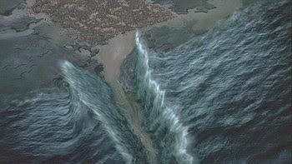
The Great Escape
21 Then Moses stretched out his hand over the sea; and the Lord caused the sea to go back by a strong east wind all that night, and made the sea into dry land, and the waters were divided. 22 So the children of Israel went into the midst of the sea on the dry ground, and the waters were a wall to them on their right hand and on their left.

Slide 14
The Great Escape
23 And the Egyptians pursued and went after them into the midst of the sea, all Pharaoh's horses, his chariots, and his horsemen. 24 Now it came to pass, in the morning watch, that the Lord looked down upon the army of the Egyptians through the pillar of fire and cloud, and He troubled the army of the Egyptians.

Slide 15
The Great Escape
25 And He took off their chariot wheels, so that they drove them with difficulty; and the Egyptians said, "Let us flee from the face of Israel, for the Lord fights for them against the Egyptians."26 Then the Lord said to Moses, "Stretch out your hand over the sea, that the waters may come back upon the Egyptians, on their chariots, and on their horsemen."

Slide 16
The Great Escape
27 And Moses stretched out his hand over the sea; and when the morning appeared, the sea returned to its full depth, while the Egyptians were fleeing into it. So the Lord overthrew the Egyptians in the midst of the sea. 28 Then the waters returned and covered the chariots, the horsemen, and all the army of Pharaoh that came into the sea after them. Not so much as one of them remained.

Slide 17
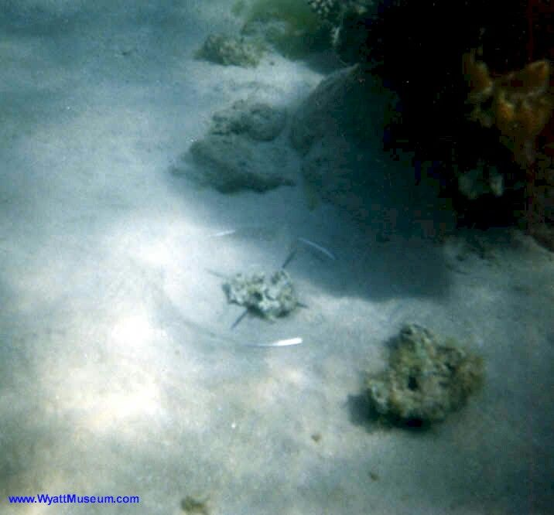
The Great Escape

Slide 18
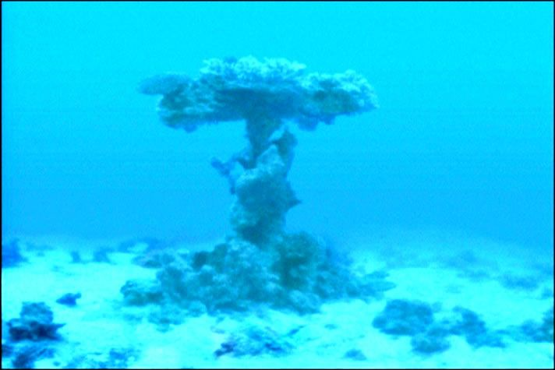
The Great Escape

Slide 19
The Great Escape

Slide 20
The Great Escape
29 But the children of Israel had walked on dry land in the midst of the sea, and the waters were a wall to them on their right hand and on their left.30 So the Lord saved Israel that day out of the hand of the Egyptians, and Israel saw the Egyptians dead on the seashore. 31 Thus Israel saw the great work which the Lord had done in Egypt; so the people feared the Lord, and believed the Lord and His servant Moses.

Slide 21
Lessons for us today
We must trust in God
We may be afraid but God is always with the faithful.

Slide 22
Conclusion
1. The people of Israel saw the salvation of the Lord

Slide 23
Conclusion
And Moses said to the people, "Do not be afraid. Stand still, and see the salvation of the Lord, which He will accomplish for you today. For the Egyptians whom you see today, you shall see again no more forever. Exodus 14:13

Slide 24
Conclusion
30 So the Lord saved Israel that day out of the hand of the Egyptians, and Israel saw the Egyptians dead on the seashore.
Exodus 14:30

Slide 25
Conclusion
2. We see the salvation of God today by obeying His commands, knowing and trusting that we have a heavenly home waiting for us, if we will cling to Him.

Slide 26
Conclusion
that you may love the Lord your God, that you may obey His voice, and that you may cling to Him, for He is your life and the length of your days…
Deuteronomy 30:20a

