Slide 1
Alcohol
Proverbs 23:29-35, 1 Thessalonians 5:22

Slide 2
What does the World Say?
It’s a pass time.

Slide 3
What does the World Say?
It’s a status symbol.

Slide 4
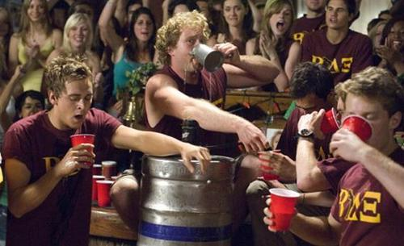
What does the World Say?
It’s fun.

Slide 5
Effects of Alcohol
Effects on your health
Resveratrol might be a key ingredient in red wine that helps prevent damage to blood vessels, reduces "bad“ cholesterol and prevent blood clots.
Mayoclinic.com

Slide 6
Alcohol and it’s effects
The effects are evident
Effects on your health –?Resveratrol?
Some research studies suggest that red and purple
grape juices may provide some of the same heart
benefits of red wine, - mayoclinic.com

Slide 7
Alcohol and it’s effects
Effects on your health
Effects on the family
Effects on your spiritual life

Slide 8
Alcohol and it’s effects
Or do you not know that your body is the temple of the Holy Spirit who is in you, whom you have from God, and you are not your own? 20 For you were bought at a price; therefore glorify God in your body and in your spirit, which are God's.
1 Corinthians 6:19-20

Slide 9
Proverbs 23:29-30
Who has woe? Who has sorrow? Who has contentions? Who has complaints? Who has wounds without cause? Who has redness of eyes?30 Those who linger long at the wine, Those who go in search of mixed wine.

Slide 10
Proverbs 23:31-22
Do not look on the wine when it is red, When it sparkles in the cup, When it swirls around smoothly;32 At the last it bites like a serpent, And stings like a viper

Slide 11
Proverbs 23:33
Your eyes will see strange things, And your heart will utter perverse things.

Slide 12
Proverbs 23:34-35
Yes, you will be like one who lies down in the midst of the sea, Or like one who lies at the top of the mast, saying:35 "They have struck me, but I was not hurt; They have beaten me, but I did not feel it. When shall I awake, that I may seek another drink?"

Slide 13
Social drinking?
We have seen what the Bible says about Alcohol but what about in moderation?

Slide 14
Social drinking?
Abstain from every form of evil.
1 Thessalonians 5:22
What about 1 Timothy 5:23?

Slide 15
1 Timothy 5:23
No longer drink only water, but use a little wine for your stomach's sake and your frequent infirmities.

Slide 16
John 2:1-11
On the third day there was a wedding in Cana of Galilee, and the mother of Jesus was there. 2 Now both Jesus and His disciples were invited to the wedding. 3 And when they ran out of wine, the mother of Jesus said to Him, "They have no wine."4 Jesus said to her, " Woman, what does your concern have to do with Me? My hour has not yet come."

Slide 17
John 2:1-11
5 His mother said to the servants, " Whatever He says to you, do it."6 Now there were set there six waterpots of stone, according to the manner of purification of the Jews, containing twenty or thirty gallons apiece. 7 Jesus said to them, " Fill the waterpots with water." And they filled them up to the brim. 8 And He said to them, " Draw some out now, and take it to the master of the feast." And they took it.

Slide 18
John 2:1-11
9 When the master of the feast had tasted the water that was made wine, and did not know where it came from (but the servants who had drawn the water knew), the master of the feast called the bridegroom. 10 And he said to him, " Every man at the beginning sets out the good wine, and when the guests have well drunk, then the inferior. You have kept the good wine until now!"

Slide 19
John 2:1-11
11 This beginning of signs Jesus did in Cana of Galilee, and manifested His glory; and His disciples believed in Him.

Slide 20
Alcohol
Is it acceptable to you?
Is it acceptable to God?

