Slide 1
Colossians 3:1-3

Slide 2
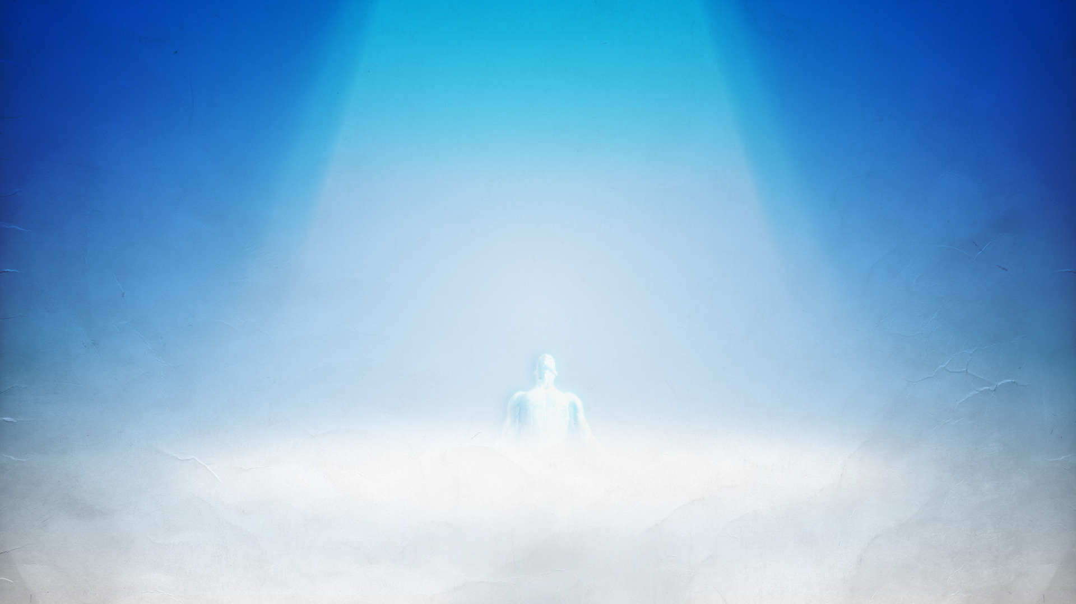
Dead to the old life of folly & sin
Verse 1a “Buried with Christ, my blessed Redeemer, Dead to the old life of folly and sin”
Therefore we were buried with Him through baptism into death, that just as Christ was raised from the dead by the glory of the Father, even so we also should walk in newness of life.5 For if we have been united together in the likeness of His death, certainly we also shall be in the likeness of His resurrection, 6 knowing this, that our old man was crucified with Him, that the body of sin might be done away with, that we should no longer be slaves of sin. Romans 6:4-6

Slide 3
Dead to the old life of folly & sin
Verse 1a “Buried with Christ, my blessed Redeemer, Dead to the old life of folly and sin”
For you died, and your life is hidden with Christ in God.
Colossians 3:3

Slide 4
Dead to the old life of folly & sin
Verse 1b “Satan may call, the world may entreat me, there is no voice that answers within”
I speak in human terms because of the weakness of your flesh. For just as you presented your members as slaves of uncleanness, and of lawlessness leading to more lawlessness, so now present your members as slaves of righteousness for holiness.
Romans 6:19

Slide 5
Dead to the old life of folly & sin
Verse 1b “Satan may call, the world may entreat me, there is no voice that answers within”
And those who are Christ's have crucified the flesh with its passions and desires.
Galatians 5:24

Slide 6
Risen with Him from the gloom and the grave
Verse 2a “Dead unto sin alive through the Spirit, Risen with Him from the gloom of the grave”
This is a faithful saying: For if we died with Him, We shall also live with Him.
2 Timothy 2:11

Slide 7
Risen with Him from the gloom and the grave
Verse 2a “Dead unto sin alive through the Spirit, Risen with Him from the gloom of the grave”
Therefore, if anyone is in Christ, he is a new creation; old things have passed away; behold, all things have become new.
2 Corinthians 5:17

Slide 8
Risen with Him from the gloom and the grave
Verse 2b “All things are new, and I am rejoicing in His great love, His power to save”
who Himself bore our sins in His own body on the tree, that we, having died to sins, might live for righteousness — by whose stripes you were healed.
1 Peter 2:24

Slide 9
Sin hath no more its cruel dominion
Verse 3a – “Sin has no more its cruel dominion, walking “in newness of life,”
For he who has died has been freed from sin. Romans 6:7
Likewise you also, reckon yourselves to be dead indeed to sin, but alive to God in Christ Jesus our Lord. Romans 6:11

Slide 10
Sin hath no more its cruel dominion
Verse 3a – “Sin has no more its cruel dominion, walking “in newness of life,”
I have been crucified with Christ; it is no longer I who live, but Christ lives in me; and the life which I now live in the flesh I live by faith in the Son of God, who loved me and gave Himself for me. Galatians 2:20

Slide 11
Sin hath no more its cruel dominion
Verse 3b – “I am free-Glorious life of Christ, my Redeemer, which He so richly shareth with me.”
But now having been set free from sin, and having become slaves of God, you have your fruit to holiness, and the end, everlasting life. Romans 6:22

Slide 12
Sin hath no more its cruel dominion
Verse 3b – “I am free-Glorious life of Christ, my Redeemer, which He so richly shareth with me.”
For the law of the Spirit of life in Christ Jesus has made me free from the law of sin and death. Romans 8:2

Slide 13
Conclusion
1. Man must truly be dead to Sin, before they can be alive again in Christ.
2. Only then, will the Christian gain heaven as their home.
a. The Christian must strive to be able to hear the temptation of sin and choose not to answer.

