Slide 1
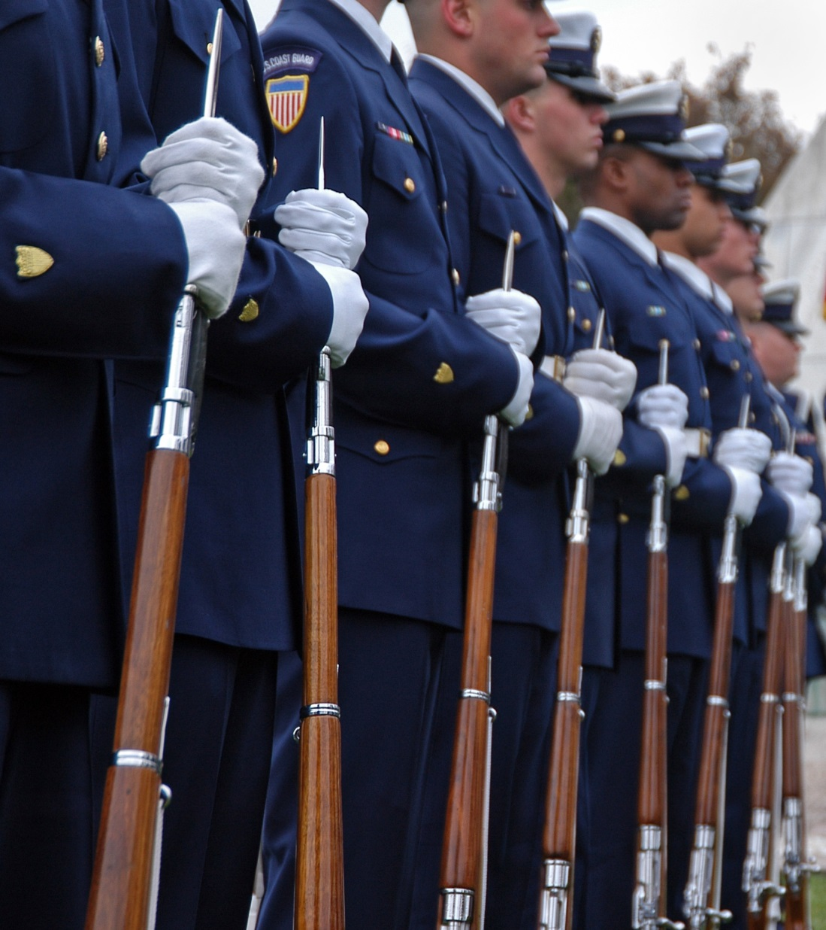
AM Sermon: Guard What was Committed to Your Trust 1 Timothy 6:20-21

Slide 2
1 Timothy 6:20-21
O Timothy! Guard what was committed to your trust, avoiding the profane and idle babblings and contradictions of what is falsely called knowledge—by professing it some have strayed concerning the faith. Grace be with you. Amen.

Slide 3
Guard What was Committed to Your Trust
the idea of isolation; to watch, that is, be on guard (literally or figuratively); by implication to preserve. (Strong’s G5442)

Slide 4
Colossians 1:23
if indeed you continue in the faith, grounded and steadfast, and are not moved away from the hope of the gospel which you heard, which was preached to every creature under heaven, of which I, Paul, became a minister.

Slide 5
2 Timothy 1:14
That good thing which was committed to you, keep by the Holy Spirit who dwells in us.

Slide 6
Romans 16:17
Now I urge you, brethren, note those who cause divisions and offenses, contrary to the doctrine which you learned, and avoid them.

Slide 7
Proverbs 21:16
A man who wanders from the way of understanding Will rest in the assembly of the dead.

Slide 8
Avoiding the profane and idle babblings and contradictions
But avoid foolish and ignorant disputes, knowing that they generate strife.
2 Timothy 2:23

Slide 9
Avoiding the profane and idle babblings and contradictions
But avoid foolish disputes, genealogies, contentions, and strivings about the law; for they are unprofitable and useless.
Titus 3:9

Slide 10
Avoiding the profane and idle babblings and contradictions
Finally, brethren, whatever things are true, whatever things are noble, whatever things are just, whatever things are pure, whatever things are lovely, whatever things are of good report, if there is any virtue and if there is anything praiseworthy—meditate on these things.
Philippians 4:8

Slide 11
Avoiding the profane and idle babblings and contradictions
as also in all his epistles, speaking in them of these things, in which are some things hard to understand, which untaught and unstable people twist to their own destruction, as they do also the rest of the Scriptures.
2 Peter 3:16

Slide 12
Of what is falsely called knowledge
Falsely (false)
not according with truth or fact
appearing to be the thing denoted; deliberately made or meant to deceive
illusory; not actually so

Slide 13
Of what is falsely called knowledge
Thus their knowledge is
NOT TRUE
DECIEVING
an ILLUSION.

Slide 14
Psalm 119:128-130
Therefore all Your precepts concerning all things I consider to be right; I hate every false way. Your testimonies are wonderful; Therefore my soul keeps them. The entrance of Your words gives light; It gives understanding to the simple.

Slide 15
How have some strayed?

Slide 16
Children’s Church or Bible Hour
Now in giving these instructions I do not praise you, since you come together not for the better but for the worse. For first of all, when you come together as a church, I hear that there are divisions among you, and in part I believe it.
1 Corinthians 11:17-18

Slide 17
Children’s Church or Bible Hour
Now on the first day of the week, when the disciples came together to break bread, Paul, ready to depart the next day, spoke to them and continued his message until midnight. There were many lamps in the upper room where they were gathered together.
Acts 20:7-8

Slide 18
Children’s Church or Bible Hour
And in a window sat a certain young man named Eutychus, who was sinking into a deep sleep…..
Acts 20:9-10

Slide 19
Children’s Church or Bible Hour
And in a window sat a certain young man named Eutychus, who was sinking into a deep sleep…..Acts 20:9-10
He was not in a Bible hour, He was present-tired to the point of falling asleep in the window-but WAS STILL PRESENT WITH ALL THE CHURCH

Slide 20
Relaxed approach to the Lord’s Supper
Jesus said to him, " 'You shall love the Lord your God with all your heart, with all your soul, and with all your mind. ' This is the first and great commandment.
Matthew 22:37-38

Slide 21
Relaxed approach to the Lord’s Supper
Therefore whoever eats this bread or drinks this cup of the Lord in an unworthy manner will be guilty of the body and blood of the Lord. But let a man examine himself, and so let him eat of the bread and drink of the cup. For he who eats and drinks in an unworthy manner eats and drinks judgment to himself, not discerning the Lord's body. For this reason many are weak and sick among you, and many sleep.
1 Corinthians 11:27-30

