Slide 1
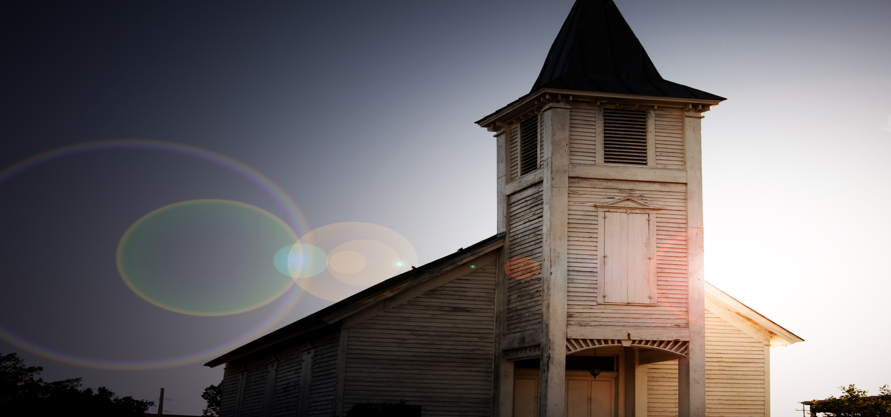
What’s the difference?
Is one church as good as another?
John 14:5-6

Slide 2
John 14:5-6
Thomas said to Him, " Lord, we do not know where You are going, and how can we know the way?"6 Jesus said to him, " I am the way, the truth, and the life. No one comes to the Father except through Me.

Slide 3
Does “one is as good as another” apply to every area?
1. Is one medicine as good as another?
2. When picking up a child from school, is one as good as another?
3. Is teaching only what people would enjoy good?

Slide 4
Does the Bible say “one is as good as another?
one Lord, one faith, one baptism;
Ephesians 4:5
Does this sound like one faith is as good as another?

Slide 5
Does the Bible say “one is as good as another?
Thomas said to Him, " Lord, we do not know where You are going, and how can we know the way?"6 Jesus said to him, " I am the way, the truth, and the life. No one comes to the Father except through Me. John 14:5-6
Christ doesn’t say another way is as good as His way.

Slide 6
Does the Bible say “one is as good as another?
There is a way that seems right to a man, But its end is the way of death. Proverbs 14:12
" Enter by the narrow gate; for wide is the gate and broad is the way that leads to destruction, and there are many who go in by it. 14 Because narrow is the gate and difficult is the way which leads to life, and there are few who find it. Matthew 7:13-14
Christ doesn’t say another way is as good as His way.

Slide 7
Does the Bible say “one is as good as another?
Then those who gladly received his word were baptized; and that day about three thousand souls were added to them.
Acts 2:41
If one religion is as good as another why did three thousand people change religions?

Slide 8
Does the Bible say “one is as good as another?
And I also say to you that you are Peter, and on this rock I will build My church, and the gates of Hades shall not prevail against it. Matthew 16:18
If one church is as good as another, then one established by man is just as good as the one Christ built!

Slide 9
Does the Bible say “one is as good as another?
But He answered and said, " Every plant which My heavenly Father has not planted will be uprooted. 14 Let them alone. They are blind leaders of the blind. And if the blind leads the blind, both will fall into a ditch.“ Matthew 15:13-14
If one church is as good as another, then one established by man is just as good as the one Christ built!

Slide 10
Does the Bible say “one is as good as another?
Unless the Lord builds the house, They labor in vain who build it… Psalm 127:1a
If one church is as good as another, then one established by man is just as good as the one Christ built!

Slide 11
Does the Bible say “one is as good as another?
Then Nadab and Abihu, the sons of Aaron, each took his censer and put fire in it, put incense on it, and offered profane fire before the Lord, which He had not commanded them. 2 So fire went out from the Lord and devoured them, and they died before the Lord. 3 And Moses said to Aaron, "This is what the Lord spoke, saying: 'By those who come near Me I must be regarded as holy; And before all the people I must be glorified. '" So Aaron held his peace.
Leviticus 10:1-3
If one worship style is as good as another, then why did God kill Nadab and Abihu for how they were worshipping Him?

Slide 12
Does the Bible say “one is as good as another?
a. Ignorant Worship (Acts 17:23)
b. Vain worship (Mt 15:9)
c. Will-worship (Col 2:23)
d. Are not as good as TRUE worship (Jn 4:24)
If one worship style is as good as another, then why did God kill Nadab and Abihu for how they were worshipping Him?

Slide 13
Which should you attend?
Is attending any church of your choice Biblical?
And I also say to you that you are Peter, and on this rock I will build My church, and the gates of Hades shall not prevail against it.
Matthew 16:18

Slide 14
Which should you attend?
Is attending any church of your choice Biblical?
Therefore take heed to yourselves and to all the flock, among which the Holy Spirit has made you overseers, to shepherd the church of God which He purchased with His own blood.
Acts 20:28

Slide 15
Which should you attend?
Where should you attend? What does Christ say?
teaching them to observe all things that I have commanded you; and lo, I am with you always, even to the end of the age." Amen.
Matthew 28:20

Slide 16
Which should you attend?
Where should you attend? What does Christ say?
Jesus said to him, " I am the way, the truth, and the life. No one comes to the Father except through Me.
John 14:6

Slide 17
Conclusion
1. If we are unwilling to be a part of the church, that Christ built, it has consequences.
2. If you are not in Christ, in His church, you can be assured you will not be in the home He has prepared for the faithful.
If you skip Christ’s church you’ll also skip heaven!

